Slide 1
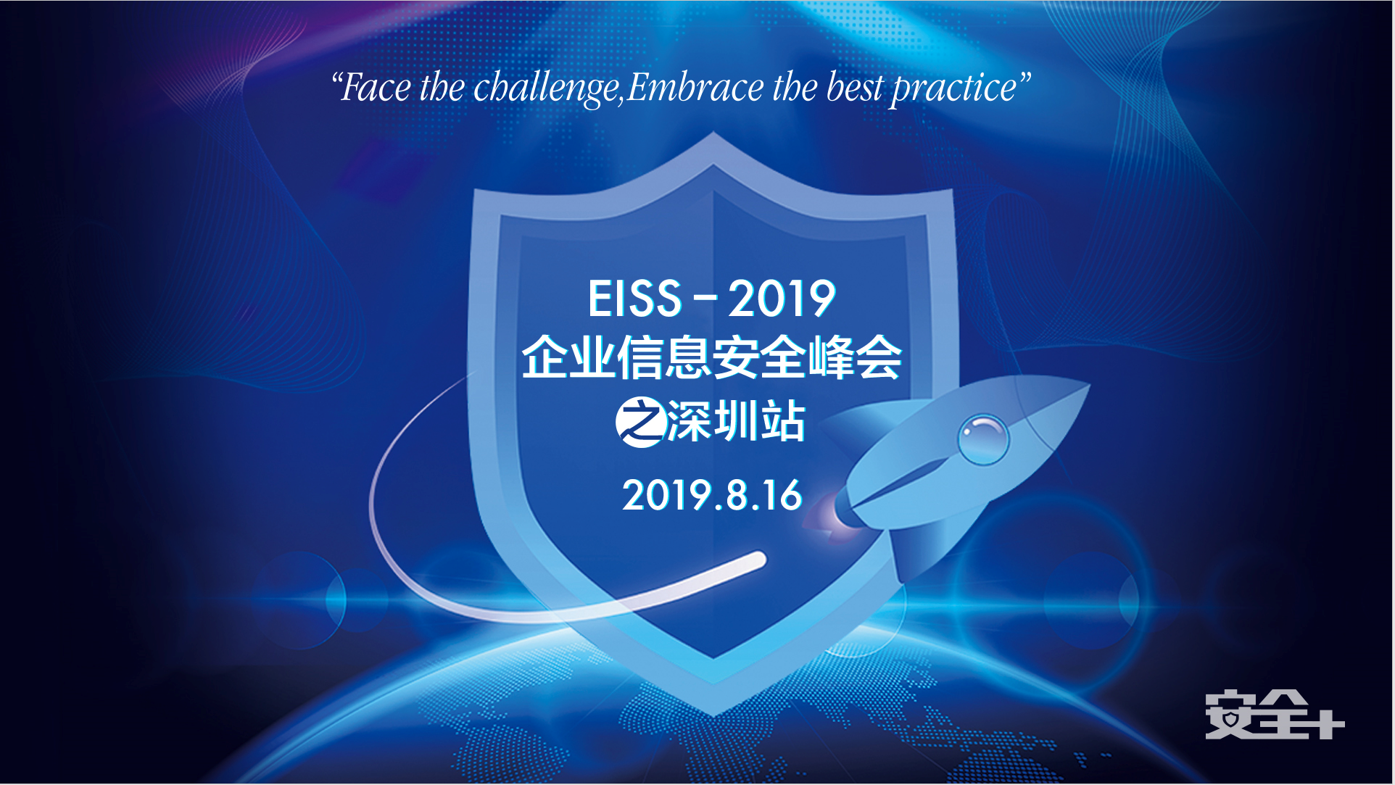

Slide 2
如何构建主动感知和弹性调整的 企业内外部网络
于涛
tao.yu@keysight.com
189 8875 6718

Slide 3



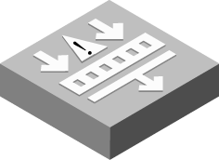



一个糖葫芦串的故事
路由器
核心交换机
IPS入侵
防御系统
WAF
DPI防火墙
外网
服务器群
路由器
IPS入侵
防御系统
WAF
DPI防火墙
核心交换机
这个网络保证任何时间不断吗？
设备能平滑扩容吗？
设备能摆脱性能瓶颈吗？
设备之间能负载分担吗？

Slide 4
一台设备上线需要面对的现实问题
路由器
交换机
外网
服务器群
Notes:
Slide 20:
Let’s start by looking at a typical inline security deployment. Everyone starts with a firewall installed at their perimeter.
[Build 1]
But then they quickly add additional inline security tools like intrusion prevention systems. The problem is that the serial deployment of all these inline security tools is dangerous.
[Build 2]
Why? Because they create multiple points of failure in the network and the networking team doesn’t appreciate that.
[Build 3]
And if the security team wants to do updates or config changes to one of these devices, they have to take the network down, or wait two weeks for the next maintenance window. And the security team doesn’t appreciate that.
So what do you do?
[Build 4]
Well most companies try to solve this issue through redundancy. They put multiple networks links in place. Each with its own set of inline security tools.
[Build 5]
But sooner or later you need to add more security tool capacity. Maybe to one tool or maybe to several tools.
In the end, the whole thing gets very complex operationally. You’ve still got lots of single points of failure. There’s lots of tension between the network and the security teams. And the whole thing is quite expensive to scale.

Slide 5
设备出现故障时
路由器
交换机
外网
服务器群
Notes:
Slide 20:
Let’s start by looking at a typical inline security deployment. Everyone starts with a firewall installed at their perimeter.
[Build 1]
But then they quickly add additional inline security tools like intrusion prevention systems. The problem is that the serial deployment of all these inline security tools is dangerous.
[Build 2]
Why? Because they create multiple points of failure in the network and the networking team doesn’t appreciate that.
[Build 3]
And if the security team wants to do updates or config changes to one of these devices, they have to take the network down, or wait two weeks for the next maintenance window. And the security team doesn’t appreciate that.
So what do you do?
[Build 4]
Well most companies try to solve this issue through redundancy. They put multiple networks links in place. Each with its own set of inline security tools.
[Build 5]
But sooner or later you need to add more security tool capacity. Maybe to one tool or maybe to several tools.
In the end, the whole thing gets very complex operationally. You’ve still got lots of single points of failure. There’s lots of tension between the network and the security teams. And the whole thing is quite expensive to scale.

Slide 6

当设备需要维护时
路由器
交换机
外网
服务器群
一次维护需要两次断网割接！！
Notes:
Slide 20:
Let’s start by looking at a typical inline security deployment. Everyone starts with a firewall installed at their perimeter.
[Build 1]
But then they quickly add additional inline security tools like intrusion prevention systems. The problem is that the serial deployment of all these inline security tools is dangerous.
[Build 2]
Why? Because they create multiple points of failure in the network and the networking team doesn’t appreciate that.
[Build 3]
And if the security team wants to do updates or config changes to one of these devices, they have to take the network down, or wait two weeks for the next maintenance window. And the security team doesn’t appreciate that.
So what do you do?
[Build 4]
Well most companies try to solve this issue through redundancy. They put multiple networks links in place. Each with its own set of inline security tools.
[Build 5]
But sooner or later you need to add more security tool capacity. Maybe to one tool or maybe to several tools.
In the end, the whole thing gets very complex operationally. You’ve still got lots of single points of failure. There’s lots of tension between the network and the security teams. And the whole thing is quite expensive to scale.

Slide 7
当设备需要升级时
高性能设备
路由器
交换机
外网
低性能设备
服务器群
无法利旧造成投资浪费！！
Notes:
Slide 20:
Let’s start by looking at a typical inline security deployment. Everyone starts with a firewall installed at their perimeter.
[Build 1]
But then they quickly add additional inline security tools like intrusion prevention systems. The problem is that the serial deployment of all these inline security tools is dangerous.
[Build 2]
Why? Because they create multiple points of failure in the network and the networking team doesn’t appreciate that.
[Build 3]
And if the security team wants to do updates or config changes to one of these devices, they have to take the network down, or wait two weeks for the next maintenance window. And the security team doesn’t appreciate that.
So what do you do?
[Build 4]
Well most companies try to solve this issue through redundancy. They put multiple networks links in place. Each with its own set of inline security tools.
[Build 5]
But sooner or later you need to add more security tool capacity. Maybe to one tool or maybe to several tools.
In the end, the whole thing gets very complex operationally. You’ve still got lots of single points of failure. There’s lots of tension between the network and the security teams. And the whole thing is quite expensive to scale.

Slide 8

是时候开始改变了。。。。
Notes:
Slide 20:
Let’s start by looking at a typical inline security deployment. Everyone starts with a firewall installed at their perimeter.
[Build 1]
But then they quickly add additional inline security tools like intrusion prevention systems. The problem is that the serial deployment of all these inline security tools is dangerous.
[Build 2]
Why? Because they create multiple points of failure in the network and the networking team doesn’t appreciate that.
[Build 3]
And if the security team wants to do updates or config changes to one of these devices, they have to take the network down, or wait two weeks for the next maintenance window. And the security team doesn’t appreciate that.
So what do you do?
[Build 4]
Well most companies try to solve this issue through redundancy. They put multiple networks links in place. Each with its own set of inline security tools.
[Build 5]
But sooner or later you need to add more security tool capacity. Maybe to one tool or maybe to several tools.
In the end, the whole thing gets very complex operationally. You’ve still got lots of single points of failure. There’s lots of tension between the network and the security teams. And the whole thing is quite expensive to scale.

Slide 9

只需要加一台Bypass交换机
路由器
交换机
Bypass交换机
外网
服务器群
设备

Slide 10
没有设备故障的烦恼
路由器
交换机
Bypass交换机
外网
服务器群
设备

Slide 11
维护设备不需要断网
路由器
交换机
Bypass交换机
外网
服务器群
设备
整个维护过程无须断网！！

Slide 12
设备冗余部署
路由器
交换机
Bypass交换机
外网
服务器群
设备1
设备2

Slide 13
多台设备组成的服务链
路由器
交换机
Bypass交换机
外网
服务器群
IPS
WAF

Slide 14
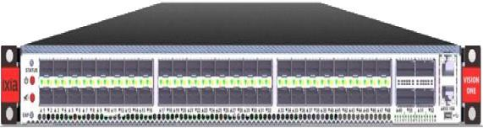
多台设备分担负载
路由器
交换机
Bypass交换机
外网
服务器群
网络交换矩阵
设备1
设备2

Slide 15
消灭设备的单点故障
路由器
交换机
Bypass交换机
外网
服务器群
网络交换矩阵
设备1
设备2

Slide 16
维护设备不需要断网
路由器
交换机
Bypass交换机
外网
服务器群
网络交换矩阵
设备1
设备2

Slide 17
实现设备的平滑扩容
路由器
交换机
Bypass交换机
外网
服务器群
网络交换矩阵
充分利旧，保护投资！！
设备1
设备2
设备3

Slide 18
针对业务流量的过滤
路由器
交换机
Bypass交换机
外网
服务器群
Web业务数据包
网络交换矩阵
其它数据包
流量经筛选后送交安全设备处理，避免不必要的资源浪费
WAF
WAF

Slide 19
针对不同用户流量的差别化的服务链
路由器
交换机
Bypass交换机
外网
服务器群
用户1
网络交换矩阵
用户2
流量经筛选后送交安全设备处理，避免不必要的资源浪费
IDS
APT

Slide 20
针对不同用户流量的差别化的服务链
路由器
核心交换机
Bypass交换机
外网
Bypass交换机
服务器群
用户1
路由器
核心交换机
用户2
网络交换矩阵
用户3
WAF
WAF
IPS入侵
防御系统
IPS入侵
防御系统
DPI防火墙
DPI防火墙

Slide 21
安全资源池
Active-Active HA部署实现毫秒级线路切换，为安全资源池提供高可用性保障

Slide 22
Active SSL
路由器
交换机
Bypass交换机
外网
服务器群
SSL加密流量
网络交换矩阵
SSL解密流量
网页加载速度的提高对web服务的成功是至关重要的。亚马逊公司曾有一个著名的发现：网页加载时间每增加100毫秒，销售额就会下降1%。
IPS入侵
防御系统
WAF
DPI防火墙
支持TLS1.0/1.1/1.2/1.3
一次加解密 - 有利于投资保护 - 实现HTTPS流量可视化
一次加解密 - 不会增加较大延迟 - 实现HTTPS流量可视化

Slide 23
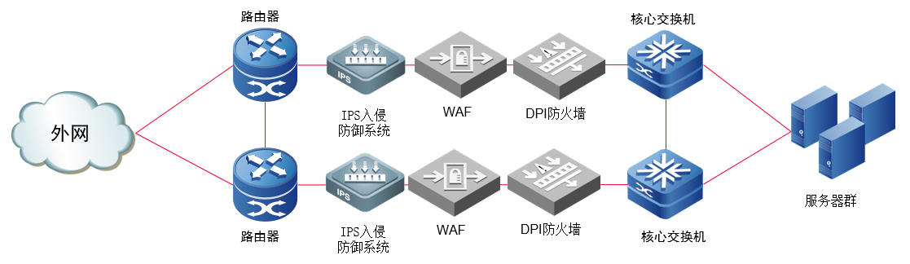
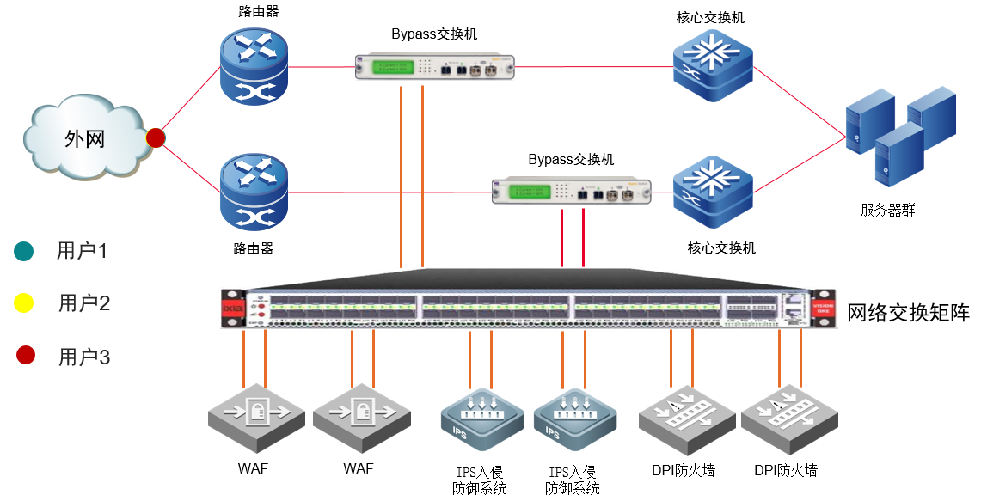
iNLINE弹性安全矩阵解决方案

Slide 24
成功案例-Inline安全矩阵项目
运营商
客户业务情况
中国三大运营商
大量业务流需要优化处理
客户需求
流量较大，单台安全设备无法处理
提高设备的利用率（负载均衡）
将特殊的流量吐给特殊的设备处理
部署结果
部署了 Ixia Vision and bypass VHD交换机
提高了Inline的可靠性
实现了弹性管理
提高了投资回报率

Slide 25


成功案例-改造前
核心层
汇聚层
8x10G LACP
Inline security system
8x10G LACP
8x10G LACP
数据中心
4x10G LACP
共280Gbps业务流量需要更安全的保障及更灵活的管理

Slide 26
成功案例-优化后
iBP VHD-1
iBP VHD-2
iBP VHD-3
10G x 28
10G x 28
10G x 56
Vision ONE-1
Vision ONE-2
10G x 4 x 8
10G x 4 x 6
DE1
DE2
DE8
DE9
DE10
DE14

Slide 27
Inline弹性安全矩阵为您的网络保驾护航！
消除串联故障，保障业务快速恢复
弹性管理，简化运维，实现不断网平滑升级、割接、扩容
负载均衡，充分利旧，提高您的投资回报比
流量过滤，复用加解密流量，提高设备利用率

Slide 28
Hawkeye鹰眼 主动式网络质量探测 ixsecure
Boost your security strength

Slide 29

主动监控
什么是主动监控?
注入流量验证网络
模拟用户行为验证用户体验
优点
在用户遭遇问题前找到问题
高性价比分布式测试终端
主动验证网络链路和服务可用性

Slide 30
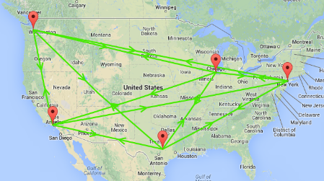
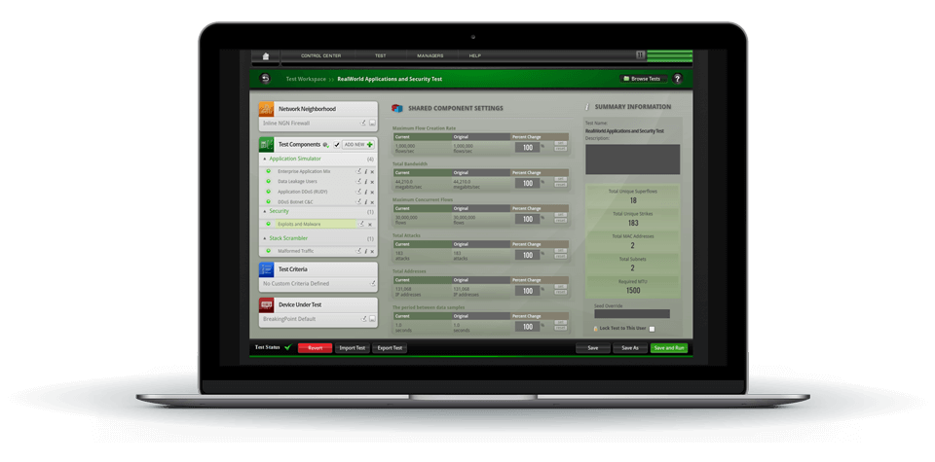
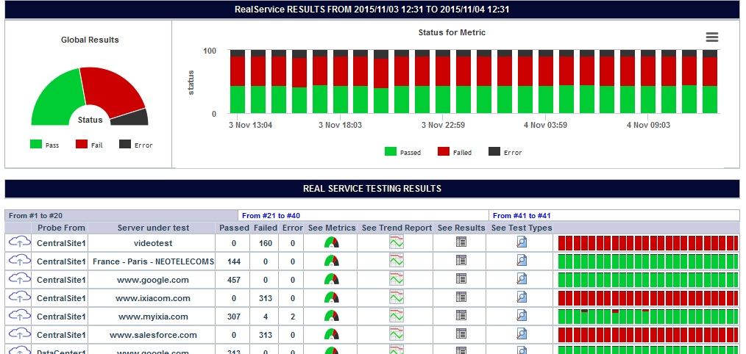
HAWKEYE 鹰眼 管理平台
值得信赖的性能指标
地理位置统计图
带宽
测试
网络 KPI 测试
语音, 视频
数据，
应用

Slide 31
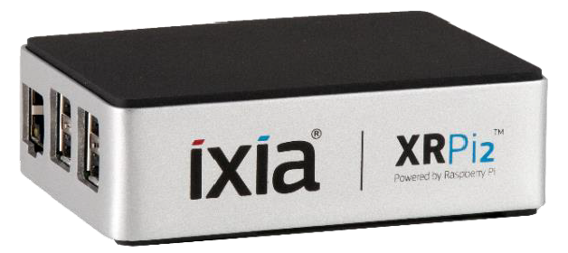
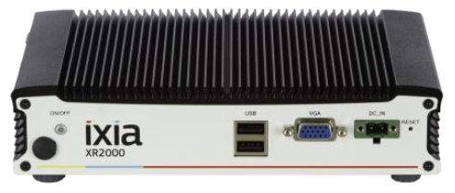






HAWKEYE 鹰眼 探针
硬件探针
轻便手提型
自动注册,自动更新
专利技术在 NAT/防火墙后连接
硬件，软件或真实服务的测试
以太网(Wi-Fi 在未来版本)
XRPI2
XR2000
软件探针
小型软件,能安装在任何设备
完美支持虚拟环境
专利技术在 NAT/防火墙后连接
硬件，软件或的测试（没有真实服务）
以太网，WiFi, 移动手机

Slide 32
NE II 主动式网络损伤仪 ixsecure
Boost your security strength

Slide 33
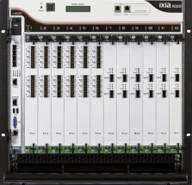



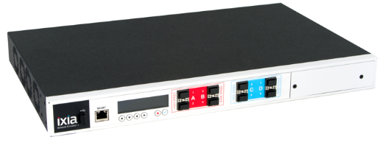
在你的实验室中进行真实网络的测试：工作原理
测试流量发生/解析系统
被测设备
链路中对流量的延时、损伤、带宽控
制/shaping和修改
被测设备
测试流量发生/解析系统
在真实网络环境下去测试你的应用程序、协议和设备
Ixia的Network Emulators是非常精准和综合有效的解决方案
最大并精准有效的去仿真，得以实现最真实的线路损伤
Notes:
Test with real world network conditions in your lab using Network Emulation!
Conveniently test your applications, services, protocols or devices against a wide range of delay, bandwidth and impairment conditions found on real-world networks allowing you to:
Evaluate performance and characterize end user experience
Perform negative or conformance type testing (corruption, modification, etc.)
Discover and fix network related issues early
Precisely reproduce and quickly resolve issues occurring in the field
Advantages over traditional testing approach
Avoids the wait-and-see approach to validating against real world environments
Saves the time and cost of building inflexible and unrealistic test networks
Non-intrusive – avoids necessity of troubleshooting on the production environment
Repeatable test methodology – compare meaningful results with colleagues and customers
Introduce real-world conditions as early in the development cycle as possible to save headaches further down the line.
Network Emulation compliments your existing generator/analyzer test equipment arsenal.

Slide 34
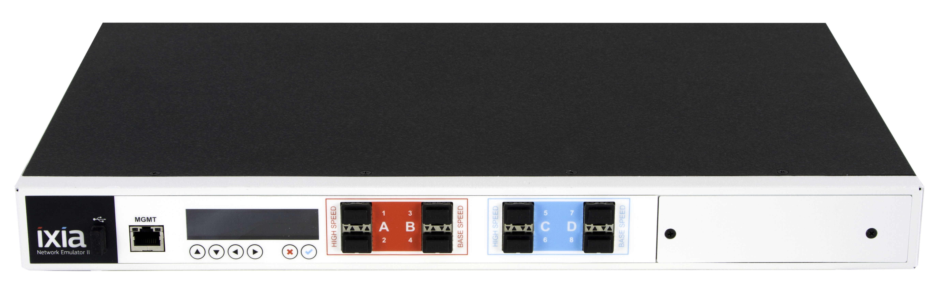
NE II主动式网络损伤仪
创建真实的网络测试环境
在部署前，发现网络延时对应用程序的影响
将真实网络的损伤应用在关键的性能测试上
在测试实验室中模拟云的迁移
模拟业务连续性、灾难性恢复测试和故障转移测试
准确地模拟无线/移动网络中的分组延迟等
卫星网络延迟仿真
测试需求
可重复性
精准性
易部署
代表真实的网络环境
为什么选择Network Emulator II
FPGA可以确保实现高精准和可重复性测试的需要
100%的线速
高端口密度和数量
方便实用的一款设备

Slide 35



是德科技 KeySIGHT-Ixia: 源自惠普—持续创新和技术领先
1939-1998 The Hewlett-Packard Years
A company founded on electronic measurement innovation
1999-2013 The Agilent Technologies Years
Spun-off from HP, Agilent becomes the world’s premier measurement company
2014 Keysight Technologies is launched
Focused singularly on electronic design and measurement solutions
2017 Keysight acquires Ixia
Notes:
And when coupled with Keysight, you are partnering with a technology innovator that has been around for over 75 years. Keysight originally known as HP was founded on electronic measurement innovation. From HP, they were spun out as part of Agilent Technologies and then as an independent company in 2014. We Keysight’s acquisition, we are bringing the best electronic measurement and test with the best of network test and visibility.

Slide 36








网络建设的长期合作伙伴
Cloud
Big Data
IoT
网络规划
实施部署
TEST
VISIBILITY
SECURITY
运维优化
Notes:
Ultimately this delivers value across the entire lifecycle, whether it’s during the network design, the rollout or when you are in live operation. And it also prepares you for the next big trends hitting the market whether it’s better harvesting big data to gain customer insights, leveraging the cloud for scale and flexibility or managing the influx of IoT devices onto your network.

Slide 37

We Make I.T. EASier
Ixia 是一家始终致力于提供专业的2-7层网络性能测试，可视性和安全解决方案厂商
TEST
SECURITY
VISIBILITY
方案更优化
部署更可靠
运维更高效
Notes:
So what is Ixia’s role in all this? We provide the tools and capabilities organizations can use to test, secure and visualize their networks so their applications run stronger. We keep pace in a changing world and take advantage of evolving technology to thinking about what issues are next, and prepare you for them.
As pioneers in the test industry, we have a long history of innovation. We have to in order to provide the widest range of validation methods against the widest range of real world events. We do this through a combination of extensive research and more importantly listening to our customers. As cloud, cyber attack methods, big data and IoT all grow at exponential rates, it becomes even more imperative to test and ‘right size’ the provisioning for your application. Ixia is the Industry leader in test.
Once you deploy, you need to see what traffic is going across your network at line rates. No delays. No missing packets. You need to see it all without slowing down your network. You need real time visibility for real time intelligence. Ixia is also an industry leader in network visibility solutions.
Applications today use a wide range of security and data analytics tools that all sit inline with your network. They each provide their own value but they also each have their own updates, patches, maintenance, and security vulnerabilities. You cannot afford for any one of them to impact your network. Ixia is an industry leader in security product tests, inline security frameworks, and network security resilience solutions.

Slide 38
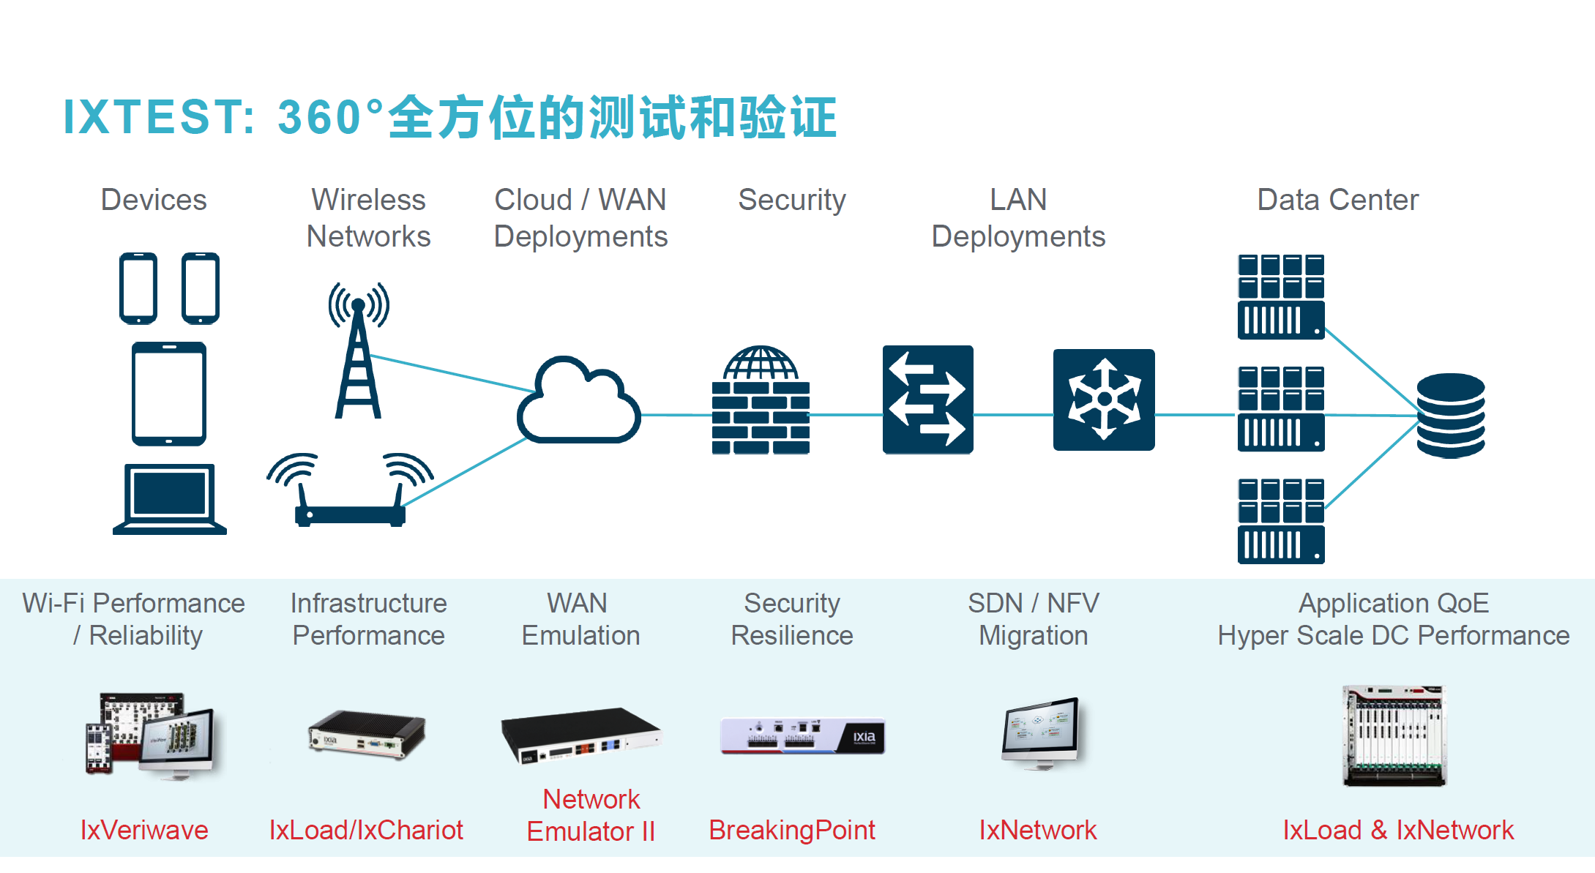

Slide 39


2019年 IXIA 发布企业安全报告正式发布
扫描下载

Slide 40


感谢您的聆听！
于涛
tao.yu@keysight.com
189 8875 6718

